Slide 1

Subject Name: Project Management
Unit No: 01
Project Management Fundamentals
Faculty Name : Dr. Bhawana Garg
1

Slide 2

Index
Lecture 1 – Definition of a project, Necessity of project management
Lecture 2 – Triple constraints, Project life cycles
Lecture3 – Project Phases
2

Slide 3

Unit No: 1
Project Management Fundamentals
Lecture No: 1
Definition of project
Necessity of project management

Slide 4
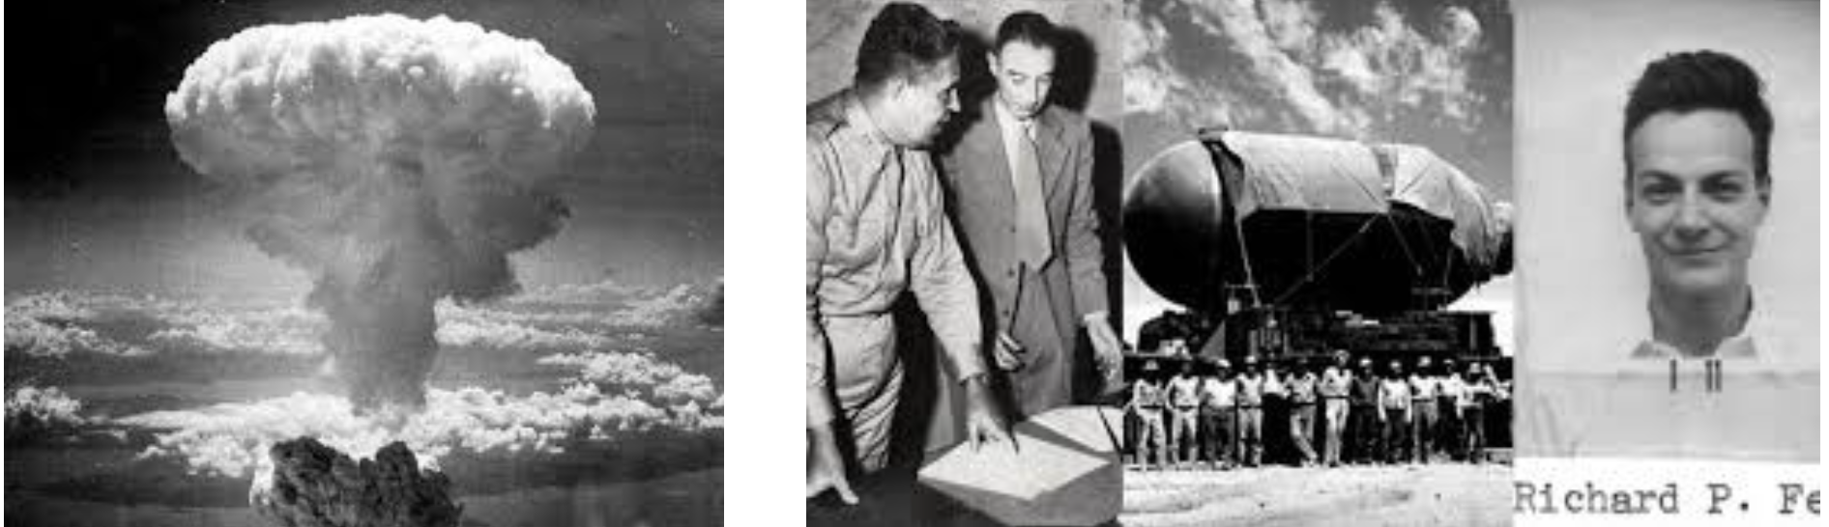
History of Project Management
The Manhattan Project was an unprecedented, top-secret World War II government program in which the United States rushed to develop and deploy the world’s first atomic weapons before Nazi Germany. The use of these weapons by the United States against Japan in August 1945 ultimately became one of the most important historical events of the 20th century.
https://www.nps.gov/mapr/learn/manhattan-project.htm

Slide 5
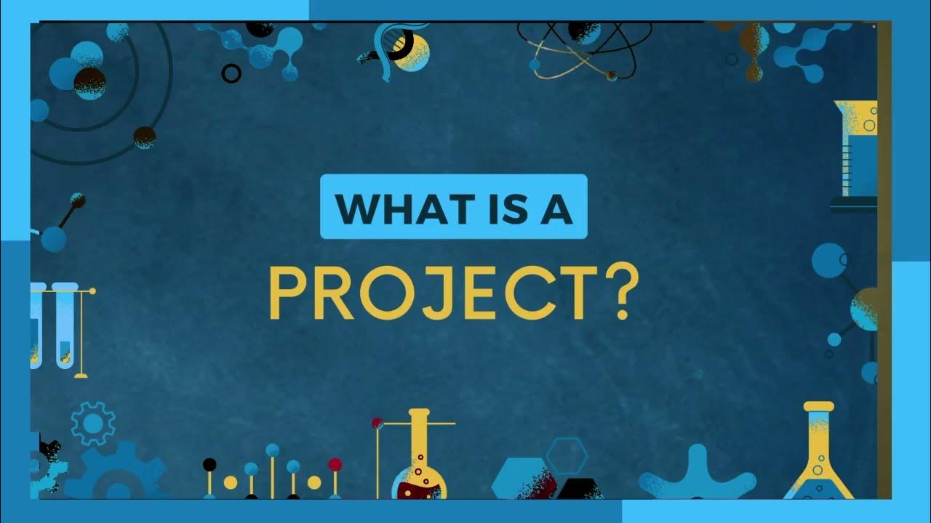

Slide 6
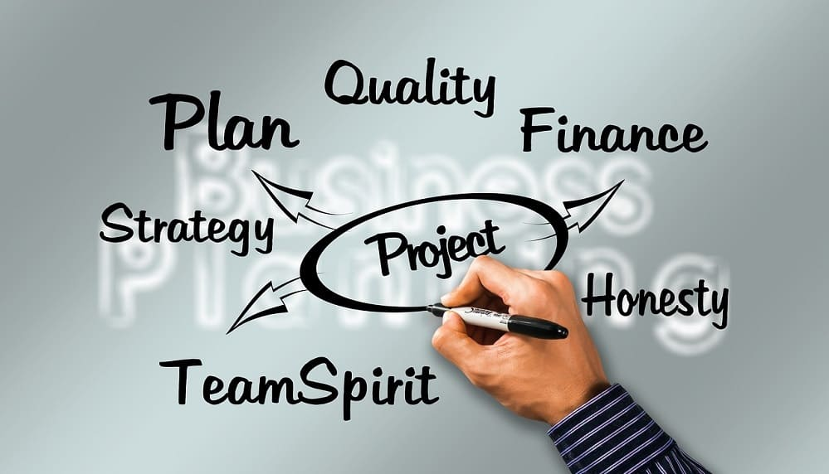
Definition of Project
A temporary endeavour undertaken to create a unique product, service, or result.
A project is a set of tasks that must be completed within a defined timeline to accomplish a specific set of goals. These tasks are completed by a group of people known as the project team, which is led by a project manager, who oversees the planning, scheduling, tracking and successful completion of projects.

Slide 7
Examples of Project
Construction: Building a block of residential homes
Marketing: Developing and implementing a marketing plan
Events: Developing a fundraising event for a non-profit organization
Manufacturing: Producing a new product
Technology: Upgrading an existing operating system
Architecture: Designing a shopping centre
Non-profit: Implementing a humanitarian relief effort
Information Technology (IT): Designing a software application
Human resources: Developing a new employee-retention strategy
Entertainment: The production of a new film

Slide 8
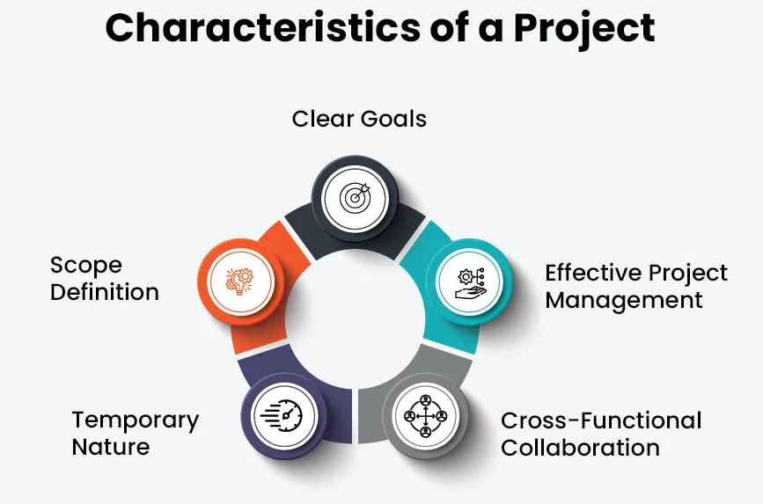

Slide 9
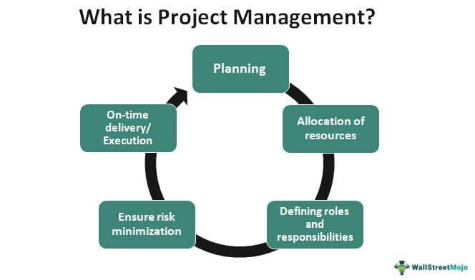
What is Project Management

Slide 10
Project management (PM) is a process or framework for leading a team through the successful completion of a project on time and within budget.

Slide 11

Necessity of Project Management

Slide 12

Clear Goals and Objective
Project management helps set clear goals and objectives. This means everyone involved knows exactly what they are working towards and what success looks like. Without clear goals, it’s easy for a project to lose direction and fail to meet its targets.

Slide 13

2. Better Planning
Detailed planning is essential for the success of any project. Project management involves creating a roadmap that outlines how the project will be completed, what resources are needed, and how long it will take. Good planning prevents wasted effort and resources

Slide 14

3. Effective Resource Management
Time, money, and manpower are limited resources. Project management ensures these resources are used wisely. By assigning the right tasks to the right people and monitoring resource usage, project management helps avoid overloading team members and running out of budget.

Slide 15

4. Risk Management
Every project faces potential risks that could derail it. Project management involves identifying these risks early and developing strategies to manage them. By anticipating problems, project managers can minimize their impact and keep the project on track

Slide 16

5. . Improved Communication
Communication is key to any project's success. Project management establishes clear lines of communication between all team members and stakeholders. This ensures everyone is informed, aligned, and able to work together effectively.

Slide 17

6. Enhanced Team Collaboration
A well-managed project fosters better teamwork. Project management clarifies roles and responsibilities, which helps team members understand their tasks and how they fit into the bigger picture. This leads to a more collaborative and productive work environment.

Slide 18

7. Quality Control
Maintaining high standards is crucial for the success of any project. Project management includes regular quality checks to ensure that the project’s deliverables meet the required standards. This prevents small issues from becoming big problems and ensures a high-quality final product.

Slide 19

8. Customer Satisfaction
Delivering projects on time, within budget, and to the expected quality directly impacts customer satisfaction. Effective project management ensures that customer expectations are met, leading to happy clients and positive business outcomes.

Slide 20
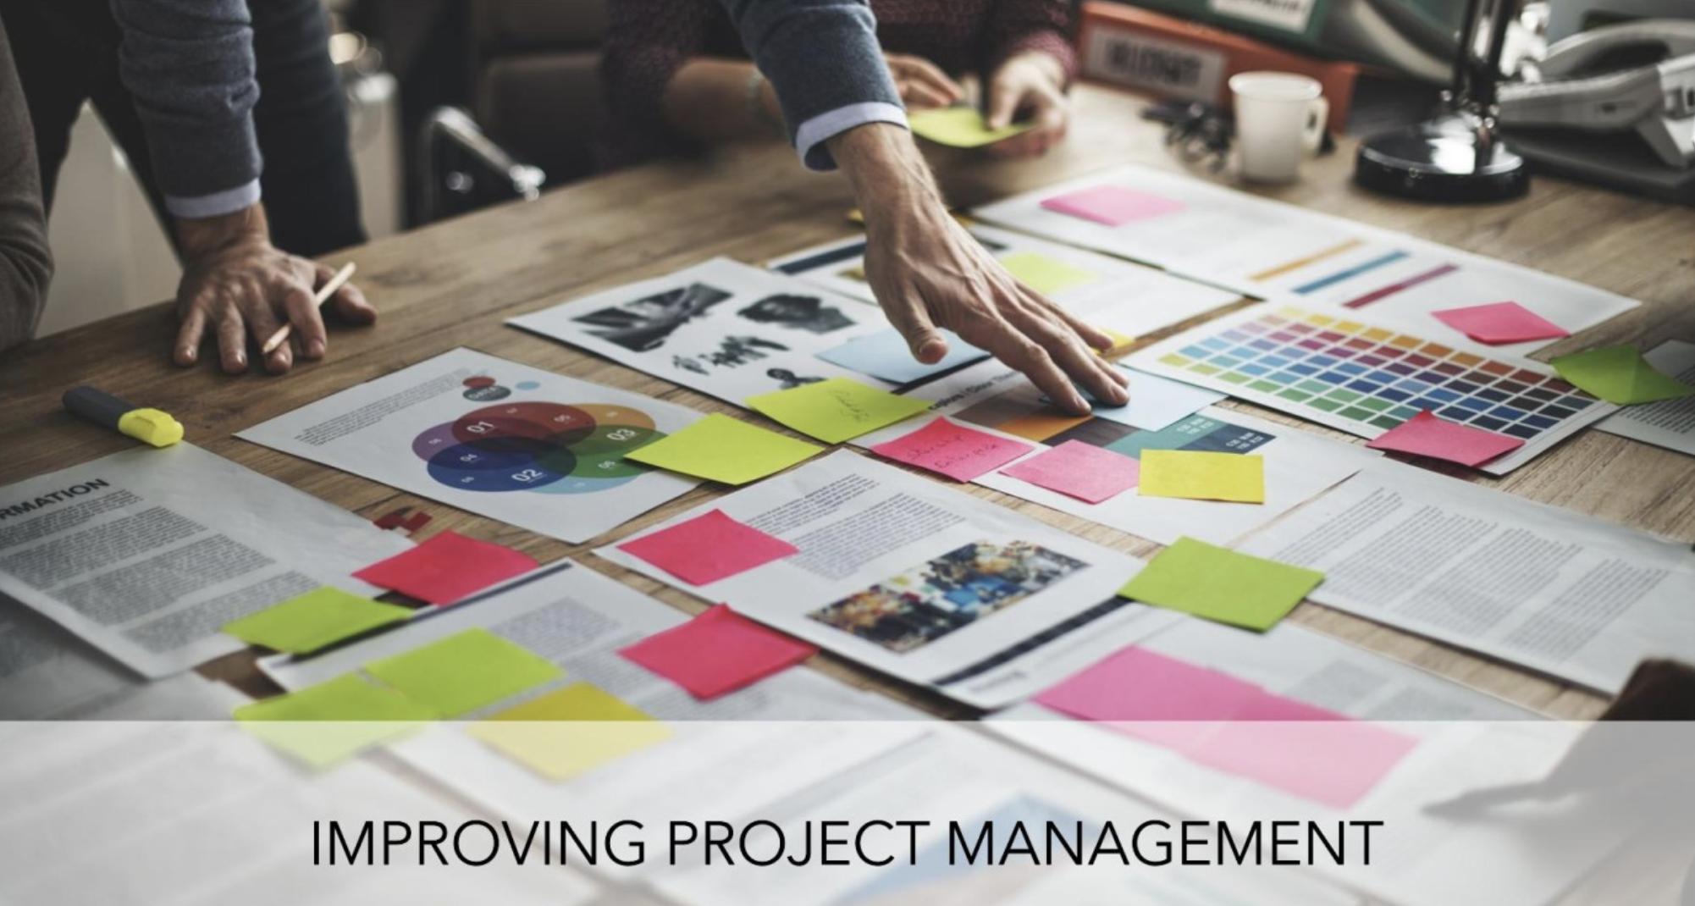
. Learning and Improvement
Every project is a learning opportunity. Project management includes reviewing what went well and what didn’t after each project. This helps teams learn from their experiences and improve their processes for future projects.

Slide 21
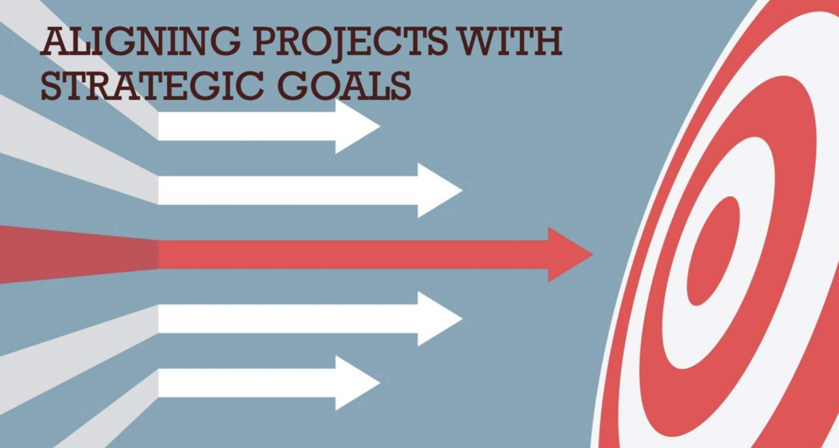
10. Achieving Strategic Goals
Projects should contribute to the larger goals of the organization. Project management aligns projects with these strategic goals, ensuring that each project helps drive the company forward. This strategic alignment ensures that resources are used effectively to achieve the most important objectives.

Slide 22
Unit No: 1
Project Management Fundamentals
Lecture No: 2
Triple constraints
Project life cycles

Slide 23
Triple constraints
What Is a Constraint?
A constraint is any limiting factor that stops you from achieving your goal, and a constraint can show itself in various ways.

Slide 24
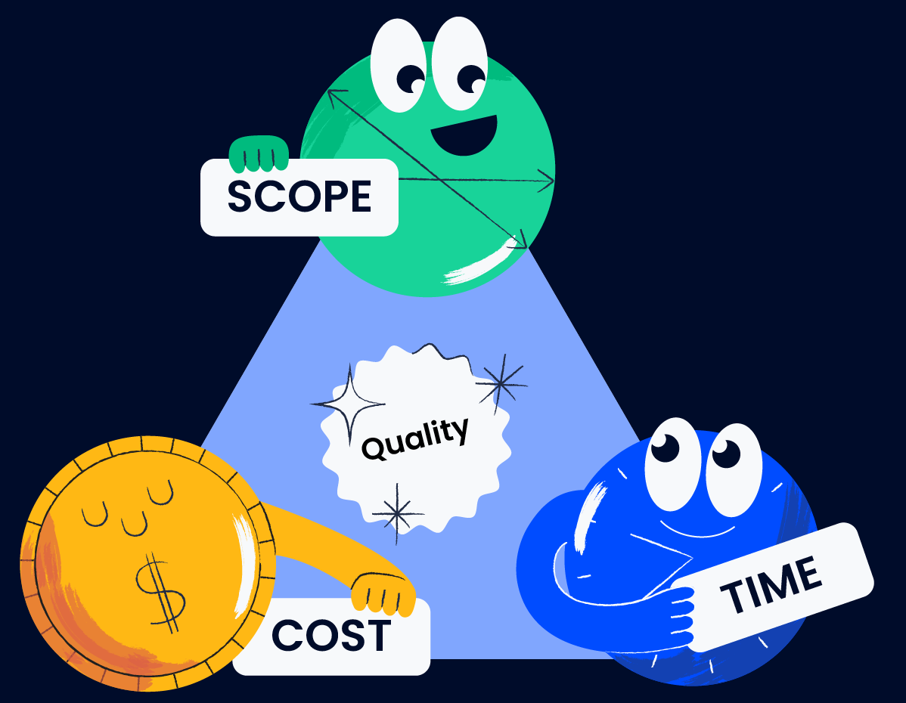
Triple Constrains
The triple constraint of project management has been given many names – the Project Management Triangle, Iron Triangle, and Project Triangle
success of the project is impacted by its costs, time, and scope. As a project manager, you can keep control of the triple constraint by balancing these three constraints through trade-offs.

Slide 25
How Does the Triple Constraint Work?
project managers can increase or reduce the cost, time and scope of a project with trade-offs to keep it on schedule and under budget
Time and Scope: You can reduce your project scope to also reduce your project duration if you’re running behind schedule. In the opposite case, you can increase the length of your project timeline in case the project stakeholders come up with extra project activities.
Cost and Scope: By reducing the project scope, you’ll need to execute fewer tasks, which means lower costs. In the opposite case, a larger project scope means higher costs.
Cost and Time: In some projects, time and cost can be directly related. For example, the costs of renting equipment or labor are directly proportional to the time you need them for.

Slide 26
Other trade-offs that can occur in a project, can be
Quality
risk
benefit.
Project managers don’t usually make these decisions alone, but rather rely on their project management office (PMO) team.

Slide 27

Project Life Cycle
A project life cycle is the series of phases that a project passes through from start to completion.
One of the benefits of a project management life cycle is its role as a guide. The phases make the process straightforward for the project manager and project team.
This way, they always know the next step and how to move projects from initiation to closure.

Slide 28
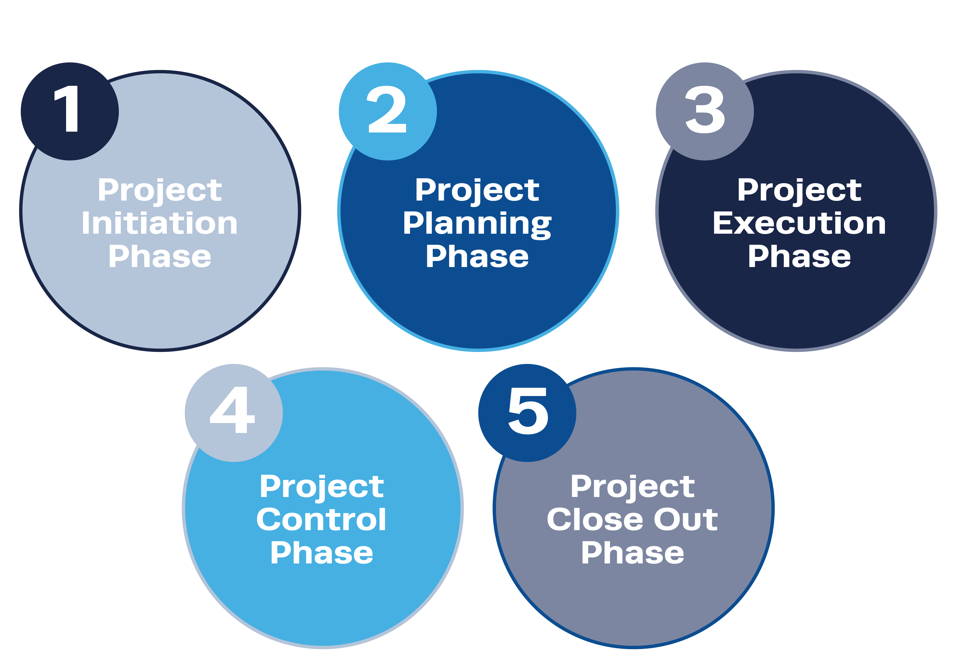
Project Life Cycle

Slide 29
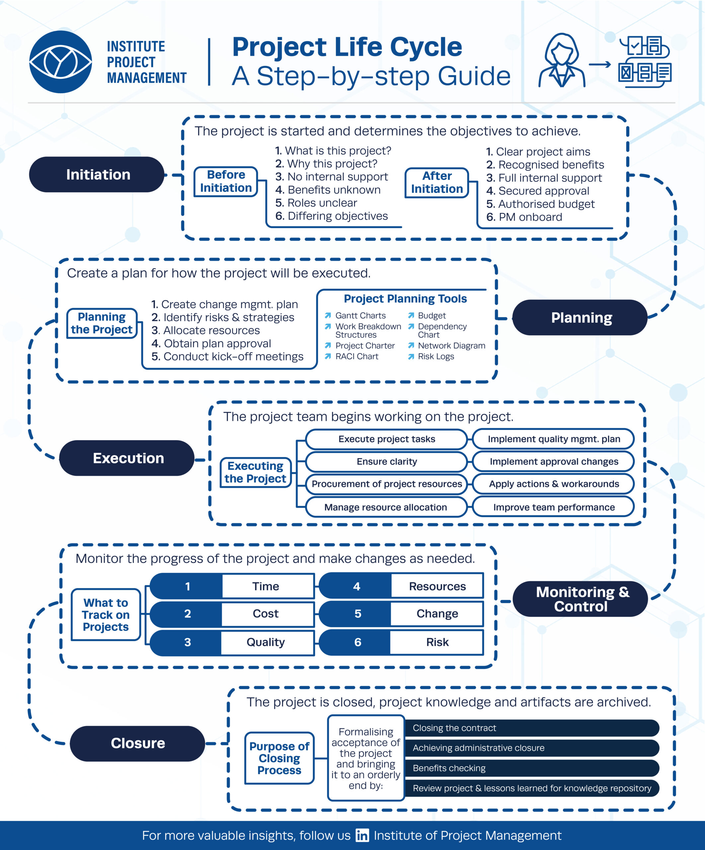

Slide 30
1. Project Initiation Phase
Project initiation is like the starting point of a project journey. It's when you decide what you want to do, why you want to do it, and who will be involved. It's all about getting everyone on the same page before you dive into the details of how to make it happen. The initial stage in beginning a new project is called project initiation. Establishing the project's purpose and the commercial value it will provide helps you gain support from important stakeholders

Slide 31
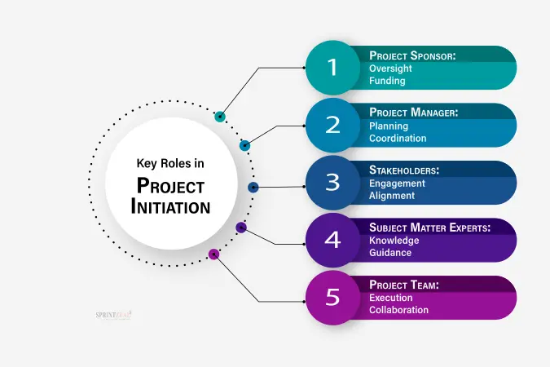

Slide 32
The Significance of the Initiation Phase
The beginning stage is when a project starts and it's the start of managing all the things related to projects.
In this stage, the project's chances of success are checked.
Also, people who have stakes or interests in the venture are found out and the first plans for it start to be made.
The choices you make when starting a project can affect how it goes forward.
They help decide whether the project will be successful or not in the future time.

Slide 33
Review
https://learning.edx.org/course/course-v1:MindEdge+4+1T2024e/block-v1:MindEdge+4+1T2024e+type@sequential+block@4d3d7be995e34ccbbfbcb888f1ebf3ab/block-v1:MindEdge+4+1T2024e+type@vertical+block@eb15a9214d4a47e0833a7adbee5a05b1

Slide 34
Benefits of a Well-Executed Initiation Phase
Clear Project Direction: During the beginning stage, it's important to set clear goals for a project. This helps guide the team and keeps them focused in one direction.
Risk Mitigation: By checking things carefully, we can find the possible dangers and problems right at the start of a project.
Resource Optimization: Starting things right means better use of stuff. By knowing the project aims, managers can figure out what talents and tools are needed.
Stakeholder Alignment: The starting stage helps to find and involve top people. This is an important part for all involved in something. Getting everyone on the same page and knowing what is expected during this part of a project helps people support it. This happens if you talk clearly with them about these needs from start to finish in their projects.

Slide 35
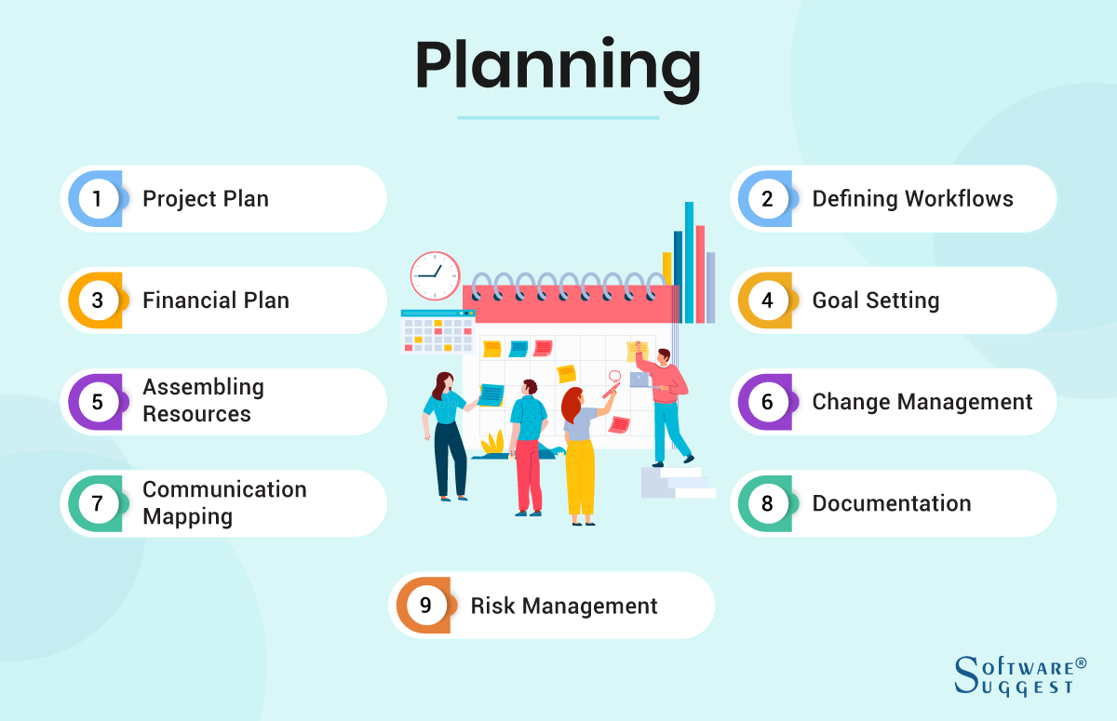
Project Planning Phase

Slide 36
Project Plan – You would typically start by creating a Project Plan. The plan would include every minute detail of the various phases of the project. In the Project Plan, you would incorporate the project’s detailed timeline, milestones, tasks involved, possible constraints, and plans to overcome them.
Defining Workflows – Workflow process refer to the steps that any work moves through from start to completion. Clearly defined workflows using diagrams can help your team better understand their responsibilities, role scope, and interactions.

Slide 37
Financial Plan – It is critical to draw up a detailed and realistic budget and financial plan in this phase. To do so, you can use available data and estimates to project expenses and return on investment.
Setting up Goals – You can use the SMART (Specific, Measurable, Achievable, Relevant, and Time-bound) or CLEAR (Collaborative, Limited, Emotional, Appreciable, and Refinable) models to set up goals during this project planning phase.

Slide 38
Assembling Resources – Before you start the actual work on the other stages of the project lifecycle, you need to have your team in place. You would also need technical, IT, financial, and other resources to be ready.
Change Management – As the goals and scope of a project can change due to the project’s dynamic nature, you need to have a change management process. Change processes can help keep the project on track and avoid scope creep.

Slide 39
Communication Mapping – This action involves establishing a communication plan, designing a communication schedule, mapping communication channels and flows, and procuring resources needed for smooth stakeholder communication.
Legal Documentation – Establishing formal and legally valid documentation like Non-disclosure Agreements (NDAs), Requests for Proposal (RFP), etc., are also part of the planning stage of the project development lifecycle.
Risk Management – A very important part of the planning step is identifying potential risks and developing a strategy to minimize them. You can use a risk register to do this smoothly. A Risk Register mentions the potential risks, their probability, possible impact, mitigation plans, etc.

Slide 40
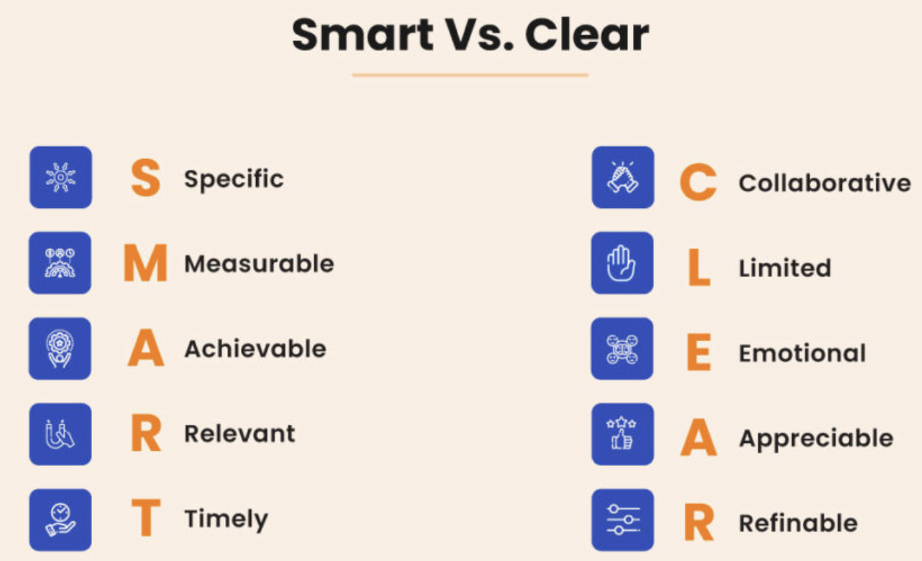

Slide 41
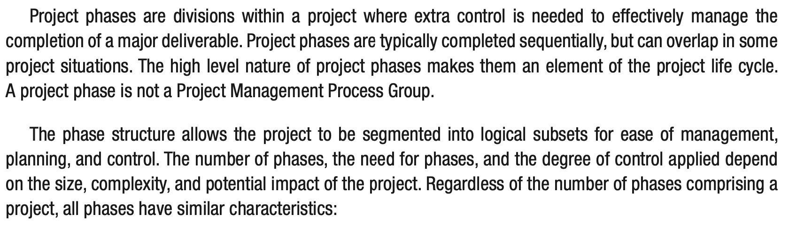
Project Phases

Slide 42
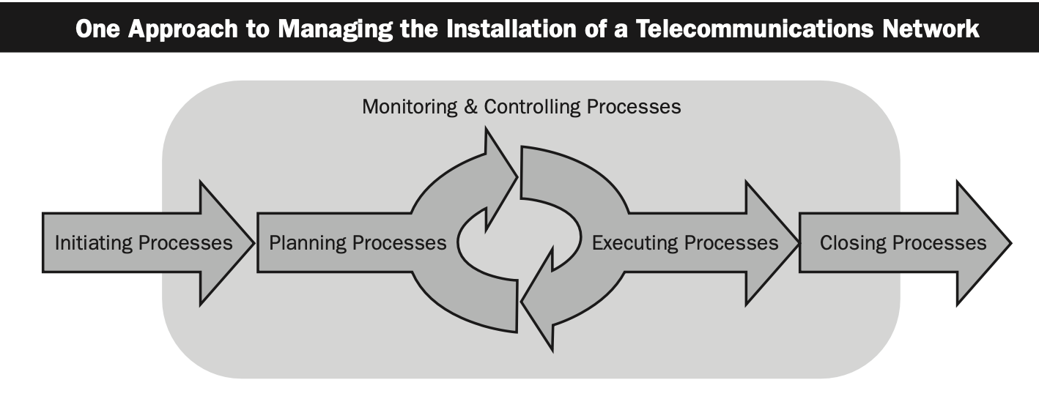
Single Phase

Slide 43
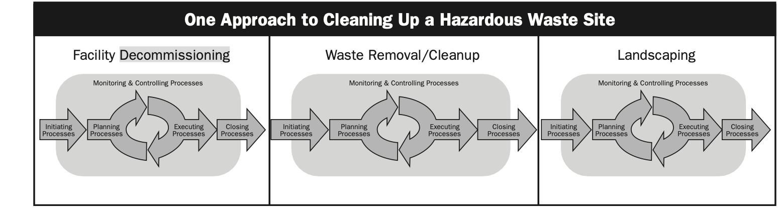
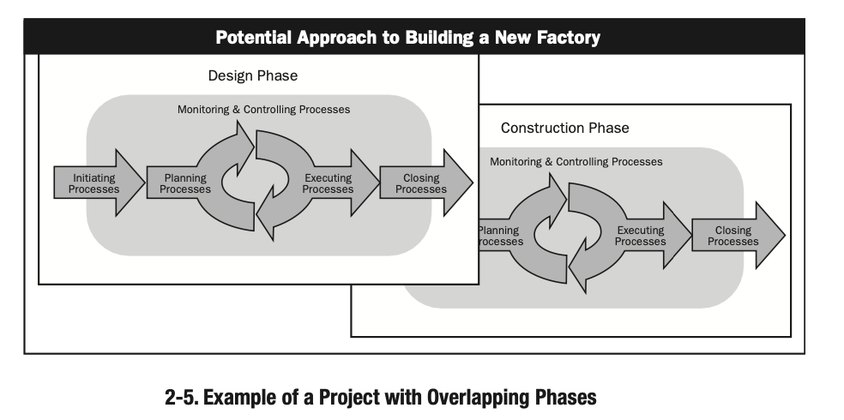

Slide 45

Thank You

